Slide 1
Things To Do Before You’re 18?

Slide 2
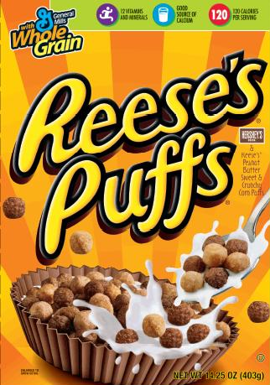
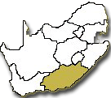

Wisdom of the World
Reese’s gave 18 things to do before 18 on the back of one of their boxes
Ride the world’s biggest rollercoaster
Bungee jump
Score the winning goal/basket
Win an award, trophy or prize
Learn an instrument
Go backstage at a gig
Meet your idol
Play a part in your favorite tv show
Meet someone with your own name

Slide 3

Wisdom of the World
Reese’s gave 18 things to do before 18 on the back of one of their boxes
Make a discovery
Get away with the perfect practical joke
Own a pointless collection
Invent a word that makes it into the dictionary
Conquer your biggest fear
Raise money for charity
Pass your driving test the first time
Complete a road trip coast to coast
Reach 18 years of age – yes!!

Slide 4

BALANCE in LIFE
(2 Tim. 3:2-4)
2 For men will be lovers of themselves, lovers of money, boasters, proud, blasphemers, disobedient to parents, unthankful, unholy,
3 unloving, unforgiving, slanderers, without self–control, brutal, despisers of good,
4 traitors, headstrong, haughty, lovers of pleasure rather than lovers of God

Slide 5
PLEASURE FROM GOD
“Command those who are rich in this present age not to be haughty, nor to trust in uncertain riches but in the living God, who gives us richly all things to enjoy” (1 Tim. 6:17)
“The wicked in his proud countenance does not seek God; God is in none of his thoughts” (Ps. 10:4; cf. 73:7-9; Hab. 1:16; Jer. 9:23, 24; 17:7f)

Slide 6
Why not do things for righteousness?
20 For when you were slaves of sin, you were free in regard to righteousness.
21 What fruit did you have then in the things of which you are now ashamed? For the end of those things is death.
22 But now having been set free from sin, and having become slaves of God, you have your fruit to holiness, and the end, everlasting life.
(Romans 6:20-23)
“Rejoice, O young man, in your youth, And let your heart cheer you in the days of your youth; Walk in the ways of your heart, And in the sight of your eyes; But know that for all these God will bring you into judgment” (Eccl. 11:9)

Slide 7
Weighty Things to DO!
1 Read Bible
2 Locate The Church
6 Weighty Things To Do Before 18

Slide 8
The Church Connects God With Man
“Therefore take heed to yourselves and to all the flock, among which the Holy Spirit has made you overseers, to shepherd the church of God which He purchased with His own blood”
(Acts 20:28)
Church
God
Man
“And the Lord added to the church daily those who were being saved” (Acts 2:47)
Ephesians 1:22, 23; 2:19-22

Slide 9
Weighty Things to DO!
1 Read Bible
2 Locate The Church
3 Obey The Gospel
5 Stand For Truth
4 Mind on Things Above
6 Teach Another
6 Weighty Things To Do Before 18

Slide 10
How To Obey The Gospel
Hear
Mk. 9:7
Believe
Heb.11:6
Repent
Acts 17:30
Baptized
Confess
Rom. 10:10
Acts 2:38

Slide 11

Weighty Things to DO!
1 Read Bible
2 Locate The Church
3 Obey The Gospel
5 Stand For Truth
4 Mind on Things Above
6 Teach Another
6 Weighty Things To Do Before 18

